Slide 1

Bad Graph Redesign Project Presentation
By Spencer Marlen-Starr
STAT 515 - Applied Statistics and Visualization for Analytics

Slide 2
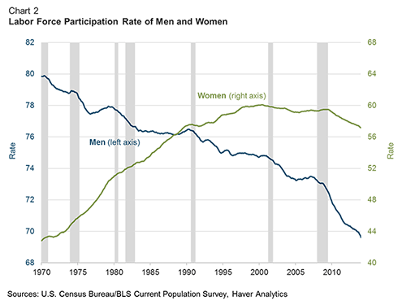
The misleading graph I chose to redesign

Slide 3
Source of the bad graph
This bad graph is originally from an economics blog post called “A Closer Look at Post-2007 Labor Force Participation Trends”
It was posted on April 8th, 2014 on the Federal Reserve Bank of Atlanta’s macroblog
It is only the second of eleven graphs included in this blog post
The authors of this post were Melinda Pitts, John Robertson, and Ellyn Terry (with explicit acknowledgements to Tomaz Cajner and Bruce Fallick as well)

Slide 4
Analysis of its flaws
If you don’t inspect it carefully, this graph appears to be saying that the labor force participation rate (LFPR from now on) of women in the United States had overtaken the LFPR of men around 1988 or 1989 when the green line in the graph intersects the blue line
I will highlight intersection this on the next slide
The graph has a different vertical axis for each LFPR line
A blue LFPR vertical axis on the left side for men
A green LFPR vertical axis on the right side for women
This might not be a problem if it was pointed out explicitly in the blog post somewhere above or below this graph, but it was not
I will highlight its lack of explanation in the next slide as well

Slide 5
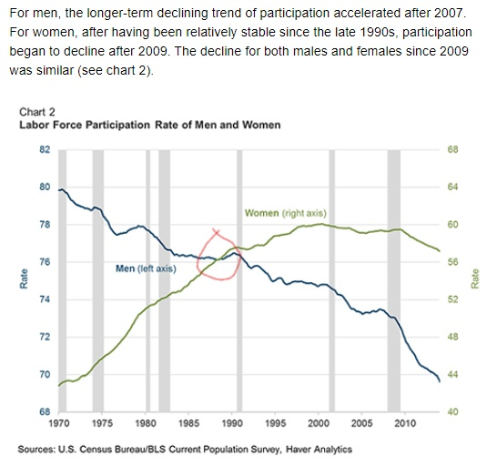
Highlighting the misleading intersection and including the description of the graph in the blog post

Slide 6
One other noteworthy flaw in the bad graphic
I instantly knew when I first saw the graph that the translucent grey rectangles throughout it represent recessions because that is a standard feature in graphs made by economists
Why?
Because I happen to have a bachelor’s degree in economics
However, most people do not have a background in economics
Everyone I showed it to who had not studied economics asked me what the grey bars were for, so an explanation of what they meant should have been included

Slide 7
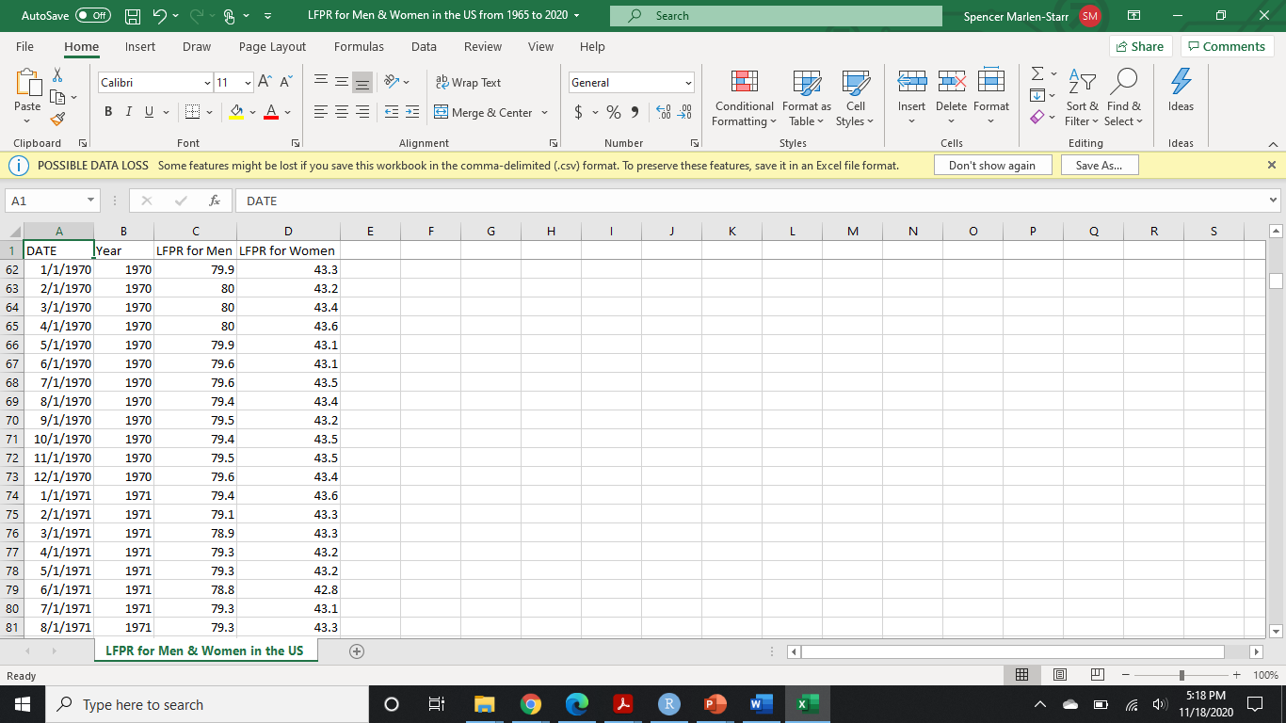
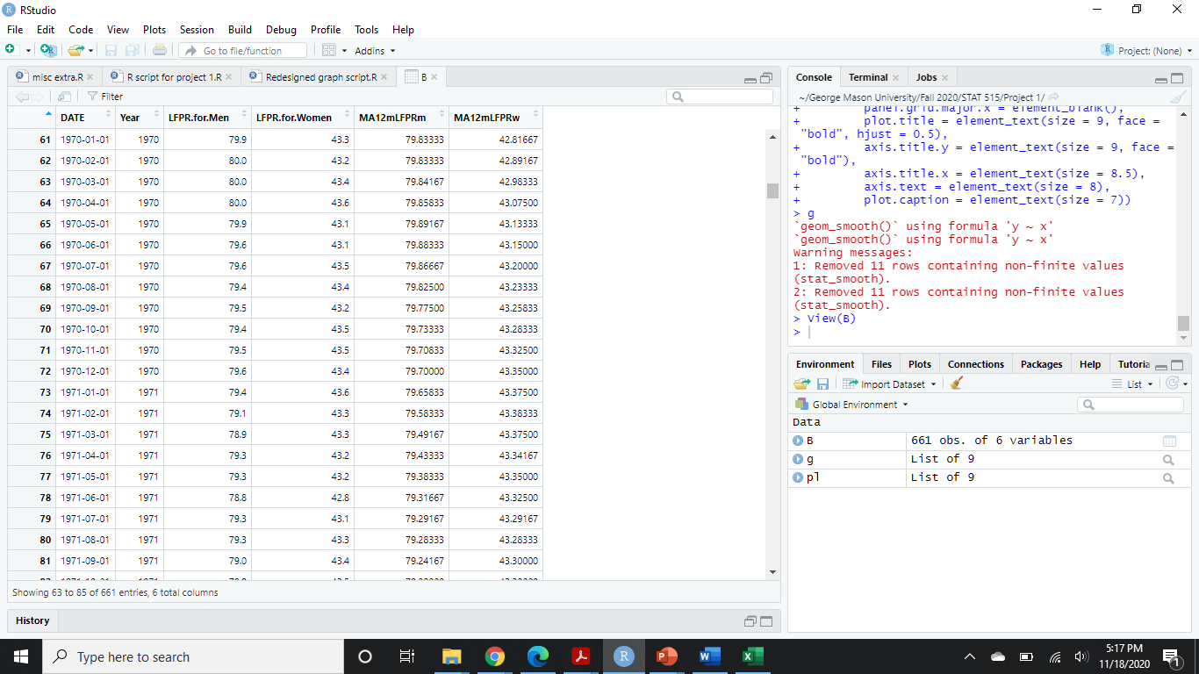
The Data
Data Source URLs:
https://fred.stlouisfed.org/series/LNS11300001?fbclid=IwAR20n9K-sZaDYUYz37XPWY76zQu8TC0lK32OcRE6K8xnzfCbTo82zwCOsQ4
https://fred.stlouisfed.org/series/LNS11300002?fbclid=IwAR2V0FKuXGZTFvmmd-o1BwrZCNLHuQp6o_XWAMvhDp0OxC5dPvN3lh_7Kl0

Slide 8
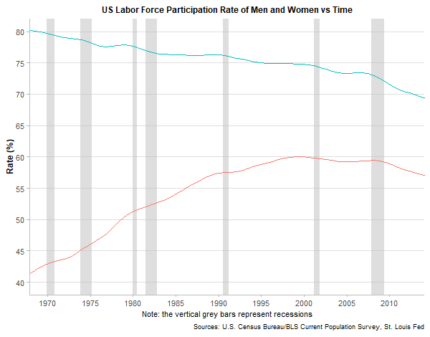
My redesign of “Chart 2”, the bad graph
Men
Women

Slide 9
Side by side comparison
Men
Women

Slide 10
R packages used in to redesign this graph
tidyverse
ggplot2
lubridate

Slide 11
Rcode used to create the graph
The code I used to create this graph is much too large to be able to fit on one or even two PPT slides
The graph was created and run starting on line 55 and ending on line 120 (that means 65 lines long!)
Because of this, I will include the R script with my upload

Slide 12
Special Efforts and Acknowledgement
To my great surprise, it was difficult for me to be able to track down a downloadable dataset of the labor force participation rate for the United States that comes separated by men and women or even datasets that have a column for sex so that I could separate them by sex myself. You can see for yourself that this is the case with the BLS Data Finder on the Bureau of Labor Statistic’s website.
Furthermore, many easy-to-use labor force participation data tools online only have data going back to the 1990s. For instance, the highly intuitive and interactive chart building tool with the option to download the data on the Labor Force Participation Dynamics webpage created by the authors 1of the article I got the bad graph from only has data going back to 1998. Another Current Population Survey data tool I found online only has data going back to 1976.
I ended up having to reach out to my good friend, the economist and econometrician, Dr. Antony Davies of Duquesne University in Pennsylvania who knew where to find it and sent me the links. I could not have completed this project without his help.

Slide 13
Bad Graph Redesign Project Presentation
By Spencer Marlen-Starr
STAT 515 - Applied Statistics and Visualization for Analytics

